Slide 1

Control Statements in Java

Slide 2
Index
The if statement
The if-else statement
The if-else ladder
The if-then-else operator
The switch statement
The while
Do..while
The For Stetement
The For Each loop

Slide 3
Conditional Statements
conditional statements are used to make decisions based on the value of your data and make the flow of the program go in different directions accordingly

Slide 4
The if..condition
public class App
{
public static void main(String[] args)
{
int temperature = 73;
if (temperature < 80)
{
System.out.println("It's not too hot.");
}
}
}

Slide 5
The if..else statement
public class App
{
public static void main(String[] args)
{
int temperature = 73;
if (temperature < 80)
{
System.out.println("It's not too hot.");
}
else
{
System.out.println("It's too hot!"); }
}}

Slide 6
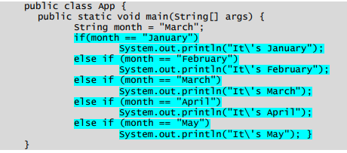
The if-else ladder

Slide 7
The if-then-else statement(ternary operator)
value = condition ? value1: value2;
if (condition)
{ value = value1; }
else { value = value2; }
Java ternary operator is the only conditional operator that takes three operands.
It’s a one-liner replacement for the if-then-else statement and is used a lot in Java programming.

Slide 8
Ternary Operations
Int num1 = 10;
Int num2 = 20;
Int res=(num1>num2) ? (num1+num2):(num1-num2)
Since num1<num2,
the second operation is performed
res = num1-num2 = -10

Slide 9
The switch statement
The switch statement is Java’s multipath branch statement;
it provides the same kind of functionality as an ifelse ladder does

Slide 10
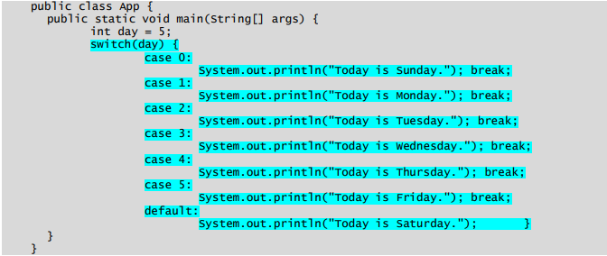
The Switch Statement

Slide 11
Loops
Loops enable you to execute a set of statements for a number of times
The loop execution depends upon a loop condition
The statements inside a loop are executed as long as the loop condition remains true

Slide 12
The while loop
A while loop executes a statement(s) inside a loop body as long as the loop test condition evaluates to true.
In general, a while loop looks as follows:
while(condition)
statement;

Slide 13
The while loop
public class App {
public static void main(String[] args)
{
int value = 10;
while (value > 0)
{
System.out.println("Current value = " + value--); } }
}

Slide 14
The while loop
public class App {
public static void main(String[] args) {
int value = 6, factorial = 1, temp;
temp = value; //make a destructive copy.
while (temp > 0)
{
factorial *= temp--;
}
System.out.println(value + "! = " + factorial);
}}

Slide 15
The do..while loop
The do-while loop is similar to a while loop.
It is also used to repeat a set of statements a number of times.
However, the difference lies where the test condition is evaluated.
A do-while loop tests the condition after the loop body is executed, whereas a while loop tests the condition before the loop body executes.
Both loops terminate once the test condition evaluates to false

Slide 16
The do..while loop
public class App {
public static void main(String[] args) {
int values[] = {1, 2, 3, 0, 5}, test, index = 0;
do {
test = 5 * values[index++];
System.out.println(test);
} while (test < 15); }
}

Slide 17
The for loop
The Java for loop is a good choice when you want to use a numeric index that you automatically increment or decrement each time through the loop, such as when you are working with an array.
for (initialization_expression; test_conditon; iteration_expression) { statement }

Slide 18
The For Loop
public class App {
public static void main(String[] args) {
int loop_index;
for (loop_index = 1; loop_index <= 5; loop_index++) {
System.out.println("This is iteration number " + loop_index); }
}
}

Slide 19
Continued…

